Slide 1
EMTH403
Mathematical Foundation for Computer Science

Slide 2
Lecture Outcomes
Understand what Spanning Trees
Understand what is Kruskal’s Algorithm.

Slide 3
Tree traversals
A binary tree is defined recursively: it consists of a root, a left subtree, and a right subtree
To traverse (or walk) the binary tree is to visit each node in the binary tree exactly once
Tree traversals are naturally recursive
Since a binary tree has three “parts,” there are six possible ways to traverse the binary tree:

Slide 4
Tree traversals
Since a binary tree has three “parts,” there are six possible ways to traverse the binary tree:
root, left, right
left, root, right
left, right, root
root, right, left
right, root, left
right, left, root

Slide 5
More binary trees examples
1. Binary tree for representing arithmetic expressions. The underlying hierarchical relationship is that of an arithmetic operator and its two operands.

Slide 6
More binary trees examples
2. Arithmetic expression in an infix form: (A - B) + C * (E / F)
+
-
*
C
A
B
F
E

Slide 7
More binary trees examples
Note that a post-order traversal of this tree (i.e. visiting the left subtree first, right subtree next, and finally the root) returns the postfix form of the arithmetic expression, while the pre-order traversal (root is visited first, then the left subtree, then the right subtree) returns the prefix form of the arithmetic expression.

Slide 8
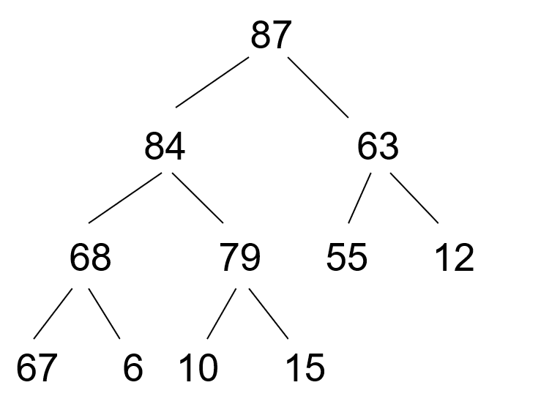
More binary trees examples
3. Binary tree with a heap property. The underlying hierarchical relationship suggests that the datum in each node is greater than or equal to the data in its left and right subtrees.

Slide 9
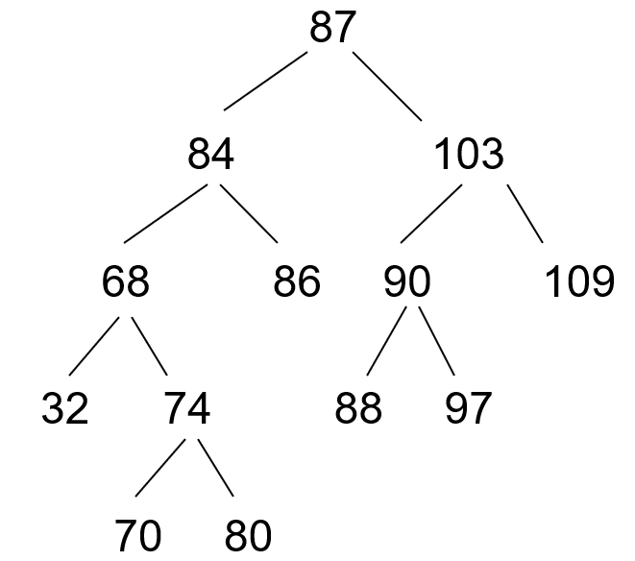
More binary trees examples
4. Binary tree with an ordering property. The underlying hierarchical relationship suggests that the datum in each node is greater than the data in its left subtree, and less than or equal to the data in its right subtrees.

Slide 10
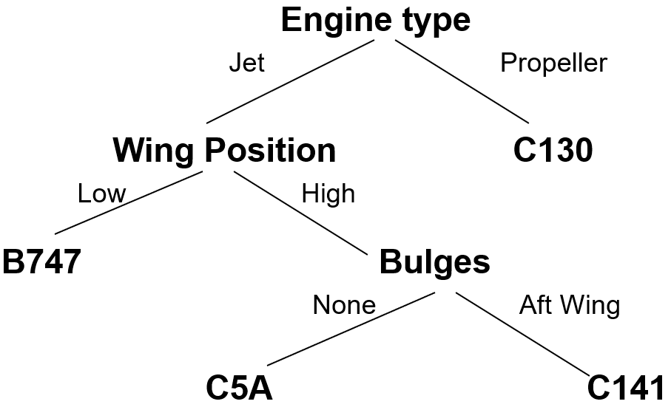

More binary trees examples
Decision trees.

Slide 11
Preoder, Inorder, Postorder
In Preorder, the root
is visited before (pre)
the subtrees traversals
In Inorder, the root is
visited in-between left
and right subtree traversal
In Preorder, the root
is visited after (pre)
the subtrees traversals
Preorder Traversal:
Visit the root
Traverse left subtree
Traverse right subtree
Inorder Traversal:
Traverse left subtree
Visit the root
Traverse right subtree
Postorder Traversal:
Traverse left subtree
Traverse right subtree
Visit the root

Slide 12
Tree traversals using “flags”
The order in which the nodes are visited during a tree traversal can be easily determined by imagining there is a “flag” attached to each node, as follows:
preorder
inorder
postorder
To traverse the tree, collect the flags:
A
A
A
B
C
B
C
B
C
D
E
F
G
D
E
F
G
D
E
F
G
A B D E C F G
D B E A F C G
D E B F G C A

Slide 13
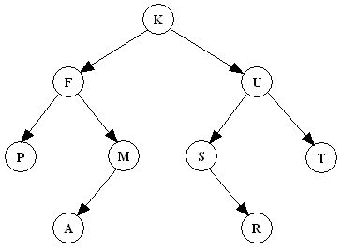
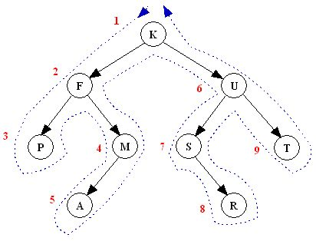
Preorder Depth-first Traversal - N-L-R
“A node is visited when passing on its left in the visit path”
K F P M A U S R T

Slide 14
Preorder Depth-first Traversal - N-L-R
M
A
Y
E
J
R
H
P
Q
T
M
A
J
Y
R
H
P
Q
T
E

Slide 15
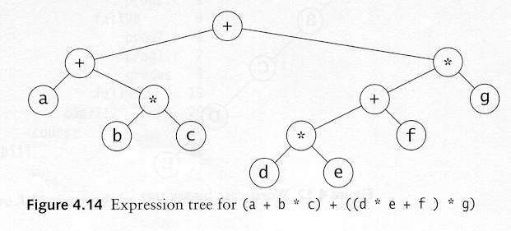
Preorder Depth-first Traversal - N-L-R
Preorder traversal node, left, right prefix expression?
Expression tree for ++a*bc*+*defg

Slide 16
Tree traversals using “flags”
The order in which the nodes are visited during a tree traversal can be easily determined by imagining there is a “flag” attached to each node, as follows:
preorder
inorder
postorder
To traverse the tree, collect the flags:
A
A
A
B
C
B
C
B
C
D
E
F
G
D
E
F
G
D
E
F
G
A B D E C F G
D B E A F C G
D E B F G C A

Slide 17
In-order Traversal: LNR
a
b
c
b
a
c

Slide 18
In-order Traversal: LNR
a
b
c
f
d
e
g
j
h
i
g
d
h
b
e
i
a
f
j
c

Slide 19
In-order Traversal: LNR
a
b
c
f
d
e
g
j
h
i
g
d
h
b
e
i
a
f
j
c

Slide 20
In-order Traversal: LNR
/
*
+
e
f
+
-
a
b
c
d
a
+
b
*
c
-
d
/
e
+
f

Slide 21
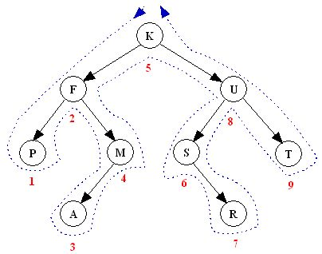
In-order Traversal: LNR
“A node is visited when passing below it in the visit path”
Note: An inorder traversal can pass through a node without visiting it at
that moment.
P F A M K S R U T

Slide 22
In-order Traversal: LNR
Inorder traversal left, node, right. infix expression?
    (a+b*c)+((d*e+f)*g)

Slide 23
Tree traversals using “flags”
The order in which the nodes are visited during a tree traversal can be easily determined by imagining there is a “flag” attached to each node, as follows:
preorder
inorder
postorder
To traverse the tree, collect the flags:
A
A
A
B
C
B
C
B
C
D
E
F
G
D
E
F
G
D
E
F
G
A B D E C F G
D B E A F C G
D E B F G C A

Slide 24
Post-order Traversal: LRV
a
b
c
b
c
a

Slide 25
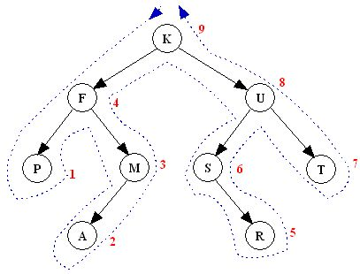
Post-order Traversal: LRV
“A node is visited when passing on its right in the visit path”
Note: An postorder traversal can pass through a node without visiting it at that moment.
P A M F R S T U K

Slide 26
Post-order Traversal: LRV
M
A
Y
E
J
R
H
P
Q
T
J
A
R
P
Q
T
H
Y
E
M
26

Slide 27
Post-order Traversal: LRV
Do a post-order traversal of the left subtree
Followed by a post-order traversal of the right subtree
Visit the node
For the sample tree
  3, 5, 4, 6, 8, 13, 10, 7
7
6
10
4
8
13
3
5

Slide 28
Post-order Traversal: LRV
Postorder traversal
  left, right, node
  postfix expression?
    (a+b*c)+((d*e+f)*g)

Slide 29
Infix Notation
Traverse in order (LVR) adding parentheses for each operation
+
↑
/
+
2
–
+
x
y
x
3
y
2
(
x
+
y
2
)
+
x
(
(
)
(
–
3
y
)
(
)
(
+
2
)
↑
/
)
29

Slide 30
Prefix Notation
Traverse in preorder (VLR)
+
↑
/
+
2
–
+
x
y
x
3
y
2
+
↑
+
x
y
2
/
–
x
3
+
y
2

Slide 31
Evaluating Prefix Notation
In an prefix expression, a binary operator precedes its two operands
The expression is evaluated right-left
Look for the first operator from the right
Evaluate the operator with the two operands immediately to its right

Slide 32
Evaluating Prefix Notation
+ / + 2 2 2 / – 3 2 + 1 0
+ / + 2 2 2 / – 3 2 1
+ / + 2 2 2 / 1 1
+ / + 2 2 2 1
+ / 4 2 1
+ 2 1
3

Slide 33
Postfix Notation
Traverse in postorder (LRV)
+
↑
/
+
2
–
+
x
y
x
3
y
2
x
y
+
2
↑
x
3
–
y
2
+
/
+

Slide 34
Postfix Notation - LRV
In an postfix expression, a binary operator follows its two operands
The expression is evaluated left-right
Look for the first operator from the left
Evaluate the operator with the two operands immediately to its left

Slide 35
Postfix Notation - LRV
Going from left to right, if you see an operator, apply it to the previous two operands (numbers)
Example:
2 10 4 * 5 / + 9 3 - -
40
6
8
10
4

Slide 36
Postfix Notation - LRV
2 2 + 2 / 3 2 – 1 0 + / +
4 2 / 3 2 – 1 0 + / +
2 3 2 – 1 0 + / +
2 1 1 0 + / +
2 1 1 / +
2 1 +
3

